Slide 1

Career Conversation 2.0
How To
November 2023

Slide 2
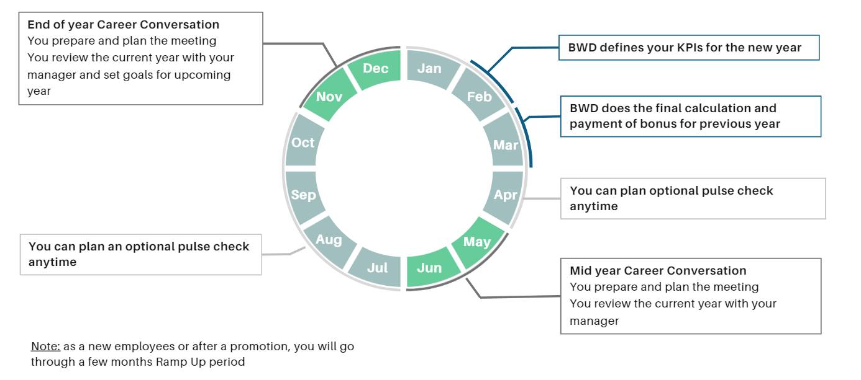
New Cycle
02
Career Conversation 2.0
2
Notes:
One thing we wanted to improve : having very clear and dedicated time of the year to meet.
Twice a year meeting cycle – mid y + end of y.
At the end of the year, you assess the current year AND define goals for the following one.
Q1 of the following year, bonuses are calculated based on your End of Y CC.
Q1 of the following year, BWD and team's Goals and KPI for the next year are defined by the managers and SLT, and communicated.
The mid y CC is a mid-term assessment : are we on track ? If yes, congrats, do we need new goals ? If not, what is the plan to catchup ?
We start NOW : in Nov-Dec 2023, we would like you to meet your manager and your team to assess performance in 2023. You use the ppt CC to prepare, fill the new excel CC to document. In Q1 2024, BWD will calculate bonuses to reward 2023 AND will communicate 2024 KPIS, partially based on your 2024 smart goals. Mid 2024, you meet your manager and your team for a mid term assessment. End of 2024, you meet again to review 2024 and define 2025 goals.

Slide 3
03
What's next?
15th November 2023 : People are invited to fill the doc.
Employee+Manager1+Manager2+Marie invited to a Teams Chat, attaching the CC.
(Margaux will create the groups and leave.)
The manager completes it and asks the employee to fill his/her part.
(Except for people reporting to SLT member : you are invited to prepare your CC).
Work collaboratively online : Do not download it, access it and fill it from Teams.
Before 31 December 2023 : It’s time to meet
At the end of the conversation, the manager sends the PDF to Marie
End of the Year 2023 CC
1/Must be completed between mid-November to end of December 2023
2/Will review 2023 ( feedback, skills, goals, values )
3/Will define 2024 Goals.
Career Conversation 2.0
3

Slide 4
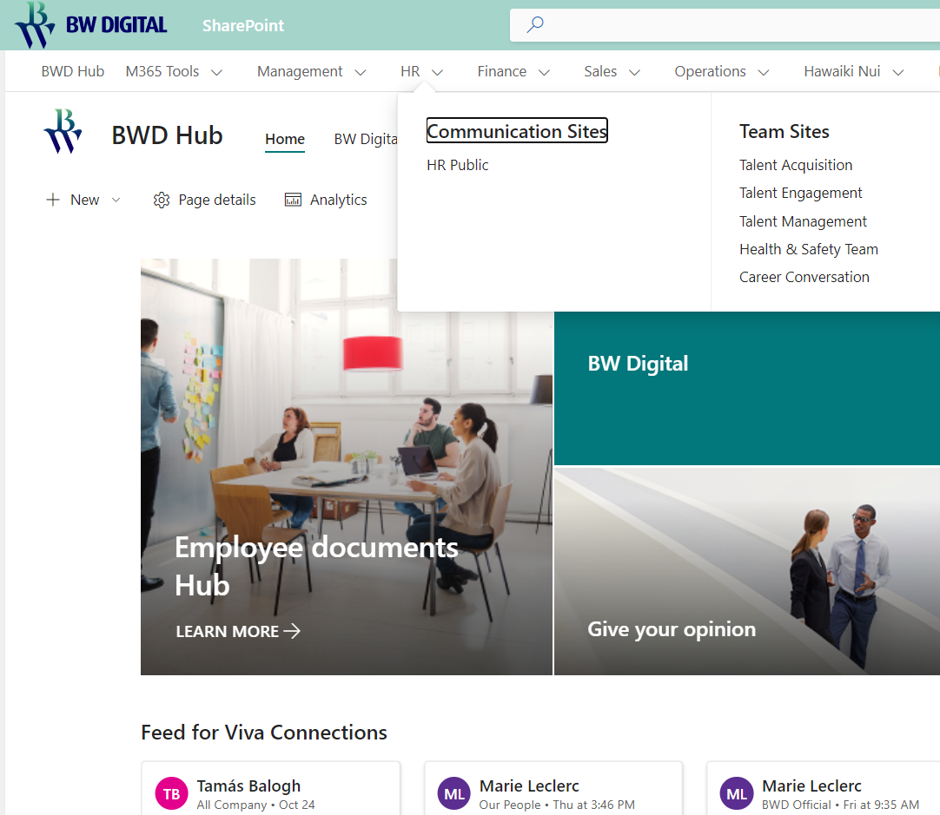
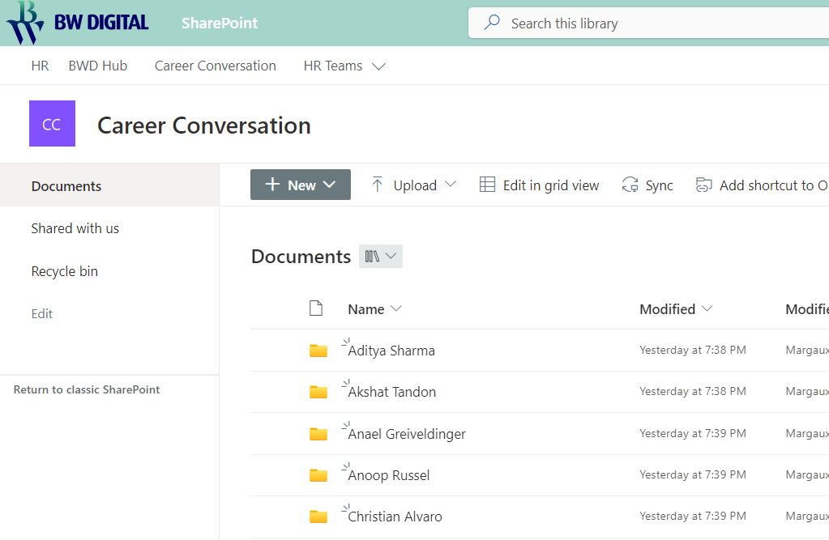
How to access / share the file? - Inside SharePoint
(from December)
05
After the SharePoint implementation, the file (same one as inside Teams) will be available in the Career Conversation site.
Also accessible (and offline) if you synched the document library in your computer
Career Conversation 2.0
4

Slide 5
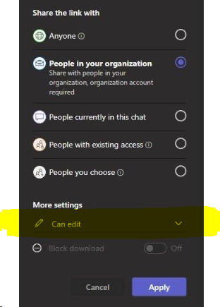
Technical Tips
06
Accessing and Using the Document:
  Accessing the Document: Before SharePoint, Margaux will invite you to a Teams Chat and will include your CC as a file. When SharePoint is live, you will find your Career Conversation document in the SharePoint site
  Review and Adjust: Some cells may be pre-filled from the previous year to make your experience smoother. Please review and adjust as needed by deleting or rewriting.
  Frequent Updates: Catchups are twice a year, but feel free to have more frequent catch-up sessions. Simply add lines to document your conversations.
  Accessing Future Years: When you need to access the document for 2025, simply unhide the corresponding pages.
  Promotions: If you get promoted, utilize the Ramp Up page for a smooth transition.
Collaborative Working:
  Collaborative Editing: Ensure that everybody involved can edit the document to facilitate collaboration and updates.
  Formatting Text: To add a line break within a cell, use ALT+ENTER.
  Document Access: Don’t download the document. Work on it directly in Teams or SharePoint. This ensures that all changes are immediately accessible to all parties and maintains the integrity of the Dashboard.
  Document Structure: Do not modify the Excel structure, as it could disrupt the functionality of the dashboard.
Career Conversation 2.0
5

Slide 6
Questions / Feedback?
@Marie
@Margaux
Career Conversation 2.0
6

